Slide 1

(career guidance)
Ali Aslam bscs13072
Usman Sarwar bscs13047
Unab Zahra bscs13045

Slide 2
Need
Education and Career Guidance
Why most of the students are not getting the degree of their interest?
Why there is a rise in unemployment rate in Pakistan?
Why people find it difficult to search for good institution?

Slide 3
Idea
Our Aim ->Provide proper education guidance system -> Students should better visualize the opportunities -> Students can choose the best for them

Slide 4
Interviews
Conducted in diverse areas of Lahore and Gujranwala
Stakeholders ->students ->teachers ->parents

Slide 5
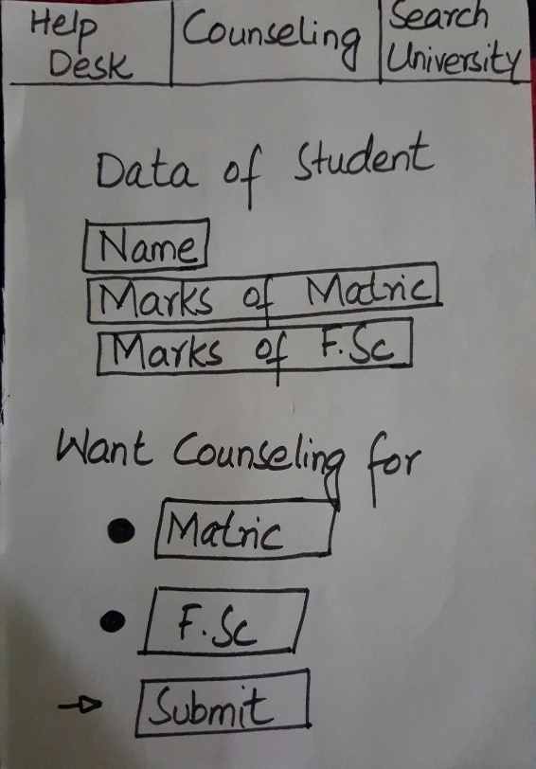
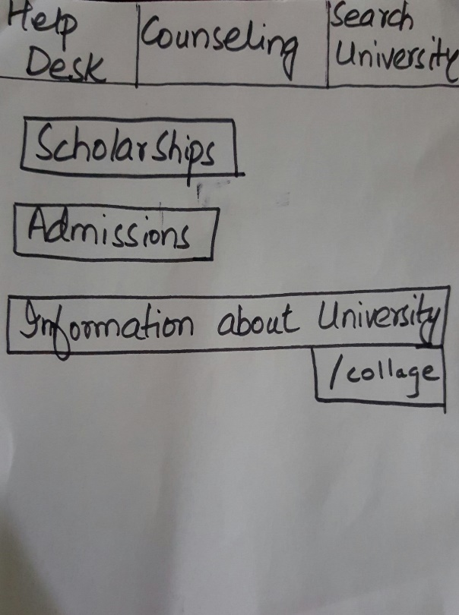
Low Fi Prototype
Android based application
Low-literate users helpline

Slide 6
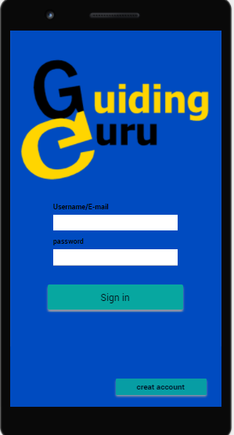
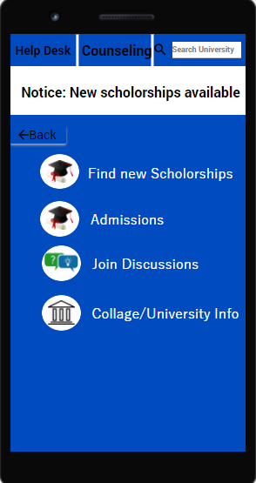
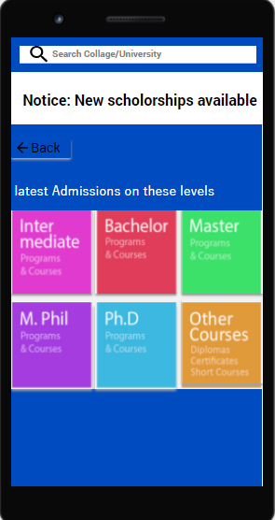
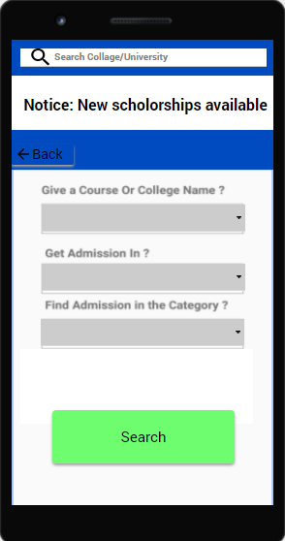
Medium Fi Prototype

Slide 7
High Fi Prototype
It will be shown on mobile

Slide 8
Testing
Heuristic Evaluation by 3 groups in the class

Slide 9
Thanks Folks!

